Slide 1

Supply
2.2
Copyright Bananaomics

Slide 2

Definition
Supply
  Supply is defined as the quantity of a good or service that producers are willing and able to offer at various prices during a specific time period, ceteris paribus
Copyright Bananaomics

Slide 3


Types of Supply
Individual
The individual supply is the supply of one product from one firm at every price.
Market
The market supply is the sum of all the individual supplies of a product at every price.
Copyright Bananaomics

Slide 4

Law of Supply
There is a DIRECT (or positive) relationship between price and quantity supplied
As the price of a good rises, the quantity supplied will usually rise, ceteris paribus. (& vise versa)
Example: Higher price = Higher QuantitySupplied. WHY? Opportunity of Profit
Copyright Bananaomics

Slide 5

Video
ACDC ECON - DEMAND AND SUPPLY EXPLAINED
Copyright Bananaomics

Slide 6

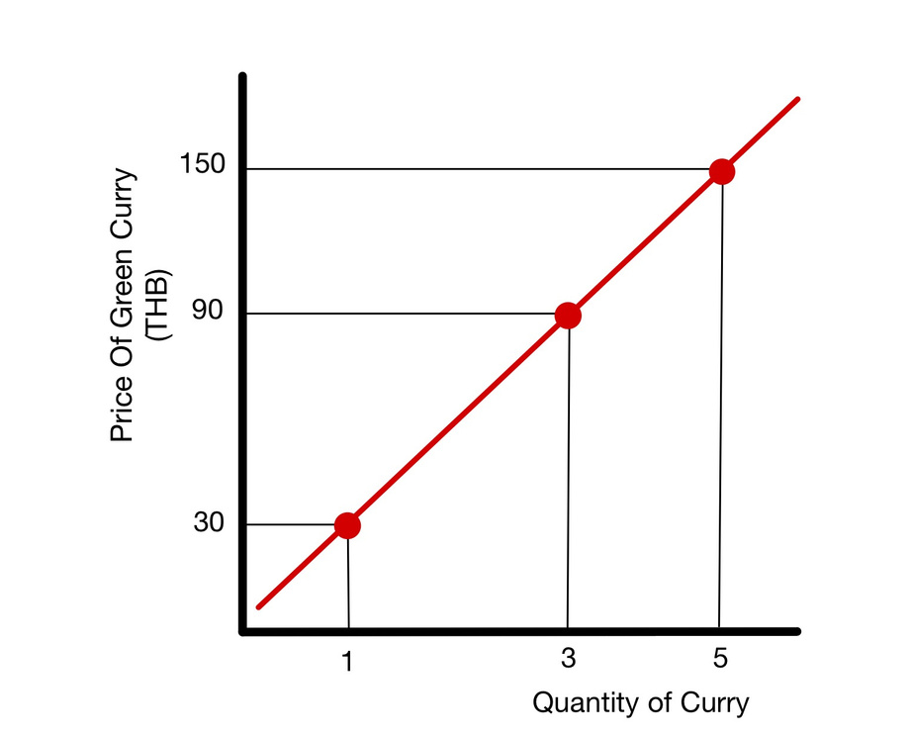
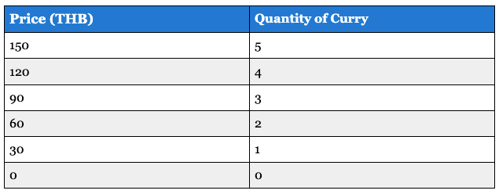

Supply Schedule
Individual
Copyright Bananaomics

Slide 7
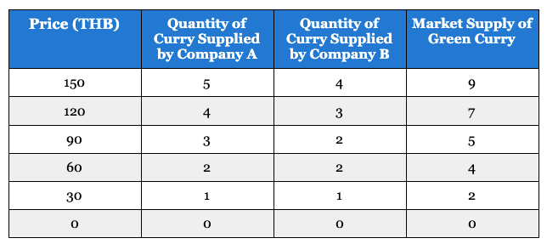
Supply Schedule
Market
Copyright Bananaomics

Slide 8


HL ONLY
Why?
The Law of Supply occurs for two main reasons.
  Law of Diminishing Marginal Returns
    Marginal returns refers to the additional output gained from adding an additional unit of input to a production process.
    The law of diminishing marginal returns states that adding more of one factor of production, while holding at least one other factor of production constant, will at some point yield lower marginal returns (output/product).
    Too many cooks in the kitchen! Must charge more because returns decrease.
  Increasing Marginal Cost of Production
    Marginal cost refers to the cost of producing one more unit of a good.
    A producer will only want to increase the quantity supplied if she can receive a higher price in the market for selling the product.
    Therefore, to make more they must charge a higher price.
Copyright Bananaomics

Slide 9
HL ONLY
Law of Diminishing Marginal Returns
ACTIVITY
With some legos/blocks, you will be building houses. Each round, you will have 1 minute to build as many as possible. Each round, 1 additional worker will be added. Students not participating in the activity, take notes on the production tally for each round and the quantity of workers.
Copyright Bananaomics

Slide 10
Video
MARGINAL REVOLUTION UNIVERSITY - THE SUPPLY CURVE
Copyright Bananaomics

Slide 11
Movements and Shifts on the Supply Curve
Copyright Bananaomics

Slide 12

Changes to the Supply Curve
1. "Change in Quantity Supplied"
  Any change in price of a product simply moves ALONG the supply curve
2. "Change in Supply"
  The entire supply curve shifts.
  Something other than price has caused a change to the supply curve
    Technical Term: Non-Price Determinant of Supply
    Example: Costs of Production
Copyright Bananaomics

Slide 13
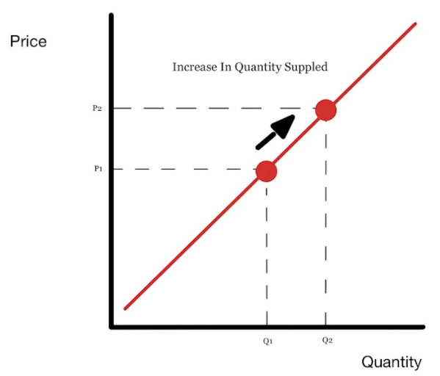
Change in Quantity Supplied
Change in Price of a Product
Copyright Bananaomics

Slide 14
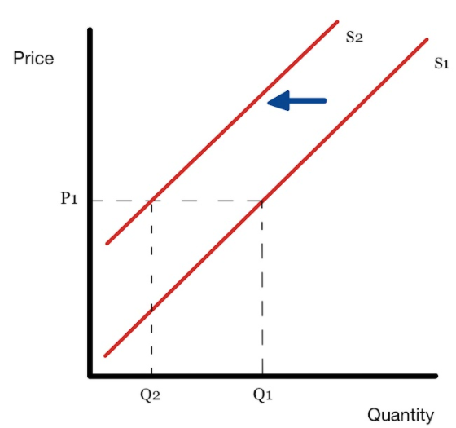
Change in Supply
Change in NON-PRICE determinant
Copyright Bananaomics

Slide 15

6 Supply Shifters
Copyright Bananaomics

Slide 16


6 Shifters of Demand
Costs of Production
Copyright Bananaomics

Slide 17

Cost of Production
Change in the cost of factors of production (FOPs) of the goods or services that firms produce is a very important factor influencing the supply.
Example: An increase in the price of flour or wheat, will likely decrease the supply of pizza
Copyright Bananaomics

Slide 18


6 Shifters of Supply
Cost of Resources/Inputs
Technology
Copyright Bananaomics

Slide 19

Technology
Improvements in a firm or industry's technology can increase the supply of a good or service by increasing productivity – the quantity of output per unit of input.
Example: The implementation of a tractor drastically increases the productivity on farms.
Copyright Bananaomics

Slide 20


6 Shifters of Supply
Cost of Resources/Inputs
Technology
Number of Firms/Sellers
Copyright Bananaomics

Slide 21

Number of Firms/Sellers
As the market supply is the sum of all the individual supplies of a product, when the number of firms that offer the same good increases, the market supply also increases, shifting the supply curve of that good outwards (to the right).
Example: If there are 100 coffee shops in Daegu, Korea, each making 100 coffee's per
day, what happens to the supply if another 50 coffee shops open?
Copyright Bananaomics

Slide 22


6 Shifters of Supply
Future Expectations
Cost of Resources/Inputs
Technology
Number of Firms/Sellers
Copyright Bananaomics

Slide 23


Future Expectations
Expectations about the future can also affect the supply for goods and services.
Future Price
Future Economy
If firms expect prices of the products they sell to increase in the near future, they might withhold part of their current production from the market (by not offering it for sale and storing it, also called hoarding ) in the hope of being able to sell more at a higher price in the future .
If producers expect the economy to do well, they will expect that people will have more money to spend and that the consumption of goods and services will increase.
Copyright Bananaomics

Slide 24

6 Shifters of Supply
Future Expectations
Cost of Resources/Inputs
Price of Related Goods
Technology
Number of Firms/Sellers
Copyright Bananaomics

Slide 25







Related Goods
Just as consumers have the choice of what alternative good to purchase when the price of one changes, producers have a choice as to what good to produce.
Joint Supply
Competitive supply
when two or more goods are derived from the same product, so that it is not possible to produce more of one without producing more of the other. The second good is often called a by-product
when the production of two goods uses similar resources and processes. When a supplier produces more of one good, it means producing less of the other.
Copyright Bananaomics

Slide 26

6 Shifters of Supply
Future Expectations
Cost of Resources/Inputs
Price of Related Goods
Technology
Government Intervention
Number of Firms/Sellers
Copyright Bananaomics

Slide 27
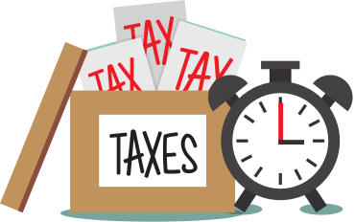


Government Intervention
Governments intervene in markets to change supply in order to achieve goals associated with the price or quantity of goods in markets. The most common methods of government intervention are regulations, indirect taxes and subsidies.
Taxes (Indirect)
Subsidies
Regulation
a tax imposed on a good or service. When indirect taxes are imposed or increased, the costs of production for firms increase, causing supply to decline
An amount of money granted by the government to a firm or industry. Subsidies have the opposite effect of a tax. When the government gives a subsidy to a firm it reduces the firm’s costs of production, increasing the supply
A regulation is a rule made by the government that requires certain behavior of individuals, firms or other groups. These rules and requirements usually increase the costs of production for firms.
Copyright Bananaomics

Slide 28

Practice
Copyright Bananaomics

Slide 29
Identify the determinant (shifter) then decide if supply will increase or decrease
Tacos (a normal good)
1.Strange virus kills 20% of cows
2.Price of tacos increase 30%
3.Government taxes taco producers
4.New tortilla baking technology cuts production time in half
5.The government subsidizes salsa producers
6.Minimum wage increases to $20

Slide 30
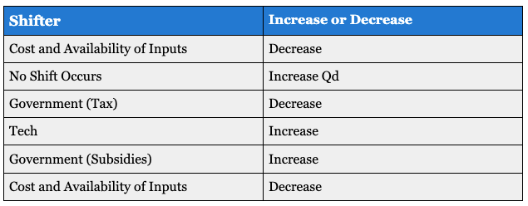

Slide 31

Recap and Review
Copyright Bananaomics

Slide 32
  Explain the law of supply.
  Draw and explain the diagram of the supply curve.
  Explain the SHIFTERS (non-price determinants) of supply
  Distinguish between movements along the supply curve and shifts in the supply curve.

Slide 33

Practice Question
Copyright Bananaomics

Slide 34
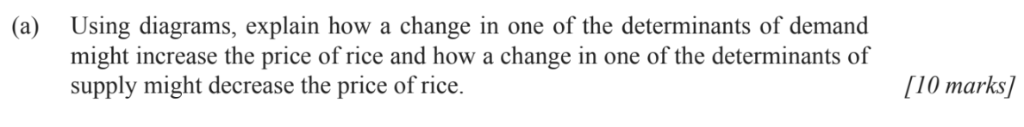
Paper 1 Part A
M14/3/ECONO/HP1/ENG/TZ1/XX
Copyright Bananaomics

Slide 35
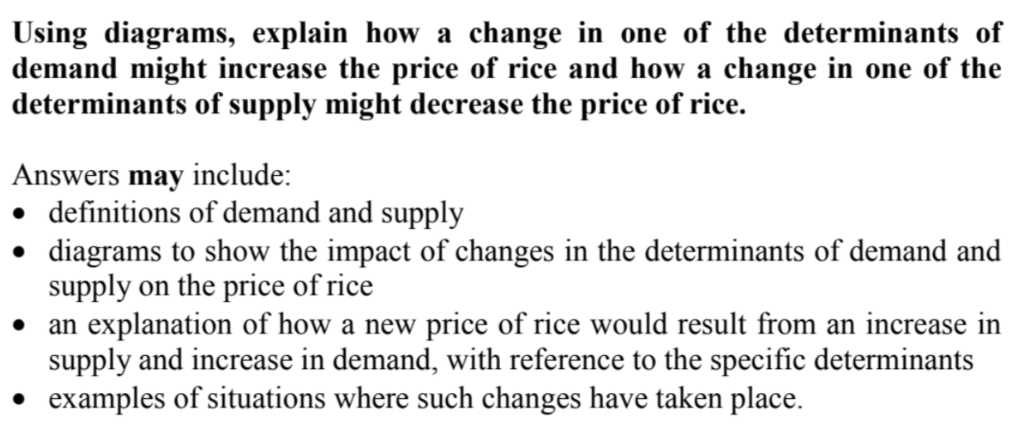
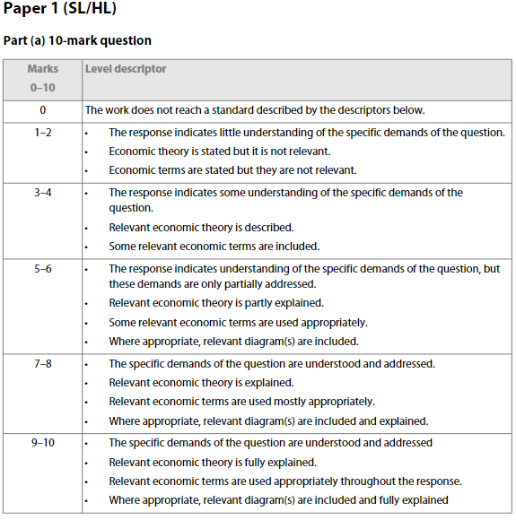
Check Answers
Copyright Bananaomics

Slide 36

Enjoying The Content?
Visit bananaomics.com to purchase package deals with discount prices!
BANANAOMICS

